Slide 1
Comparing things
12
and hypothesis testing
Probability
and
Statistics
COMS10011
Dr. Anne Roudaut
csxar@bristol.ac.uk

Slide 2
continuous independent variable
What type of data?
discrete independent variable
continuous dependent variable
discrete dependent variable
Continuous dependent variable
Discrete/categorical dependent variable
regressions
logistic
regressions
normally distributed
skewed
2 grp
>2 grp
2 grp
>2 grp
2 grp
>2 grp
Non paired
paired
Non paired
paired
Non paired
paired
Non paired
paired
Counts >= 5 in >= 75% cells
Counts >= 5 in < 75% cells
T-test
ANOVA
Mann-Whitney Utest
Wilcoxon signed rank test
Kruskall-Wallis test
Chi-square test
Fisher’s exact test
Chi-square test
Paired-t-test
Friiedman test
McNemar’s test

Slide 3
continuous independent variable
What type of data?
discrete independent variable
continuous dependent variable
discrete dependent variable
Continuous dependent variable
Discrete/categorical dependent variable
regressions
logistic
regressions
normally distributed
skewed
2 grp
>2 grp
2 grp
>2 grp
2 grp
>2 grp
Non paired
paired
Non paired
paired
Non paired
paired
Non paired
paired
Counts >= 5 in >= 75% cells
Counts >= 5 in < 75% cells
T-test
ANOVA
Mann-Whitney Utest
Wilcoxon signed rank test
Kruskall-Wallis test
Chi-square test
Fisher’s exact test
Chi-square test
Paired-t-test
Friiedman test
McNemar’s test

Slide 4
let’s start with a contrived example…

Slide 5
you own a magic pair of shoes. You have run the 10 meters with it a lot and you have a long log of the time you have run with it.
one day, you come home and it seems like someone has moved your shoes. You get concerned that someone might have taken your (beloved) shoes and instead replaced it with identical looking shoes.
you inspect the shoes long and hard and they look the same. But still worried. How do you verify that they are the same?
<30 sec brainstorming>

Slide 6
ok, so you run the 10 meters with the “questionable” shoes a bunch of times.
here is what you see…

Slide 7
2.5-3s 3-3.5s 3.5-4s 4-4.5s 4.5-5s 5-5.5s
2.5-3s 3-3.5s 3.5-4s 4-4.5s 4.5-5s 5-5.5s
your shoes
questionable shoes

Slide 8
[ ] this is still the original shoes
[ ] someone has replaced my shoes
[ ] could be the original or replacement shoes
your shoes
questionable shoes
x
<let’s vote>

Slide 9
the distribution looks different from the shoes you know
while it is possible that it is the same shoes, it seems somewhat unlikely
your die
questionable die

Slide 10
ok, let’s run some more…
2.5-3s 3-3.5s 3.5-4s 4-4.5s 4.5-5s 5-5.5s
2.5-3s 3-3.5s 3.5-4s 4-4.5s 4.5-5s 5-5.5s
your shoes
questionable shoes

Slide 11
[ ] this is probably still the original shoes
[ ] someone probably has replaced my shoes
[ ] could be the original or replacement shoes
your shoes
questionable shoes
x
x
<let’s vote>

Slide 12
again, the distribution could have happened by chance, but it seems even more unlikely. This is probably not your shoes
your shoes
questionable shoes

Slide 13
again, the distribution could have happened by chance, but it seems even more unlikely. This is probably not your shoes
your shoes
questionable shoes
are you sure this it is not your shoes?

Slide 14
you are not sure.
what can you do to be sure?

Slide 15
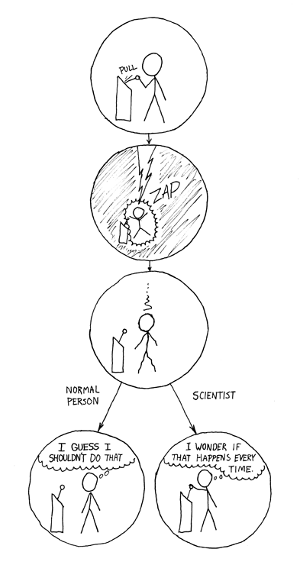
there is nothing you can do, you can never be sure
it is a limitation of science:
no matter how often you pull the lever, it could always be chance

Slide 16
the good news:
the more sample (# of runs), the more your confidence increases
→ you can be arbitrarily sure

Slide 17
another round

Slide 18
ok, you get your original shoes back
a week later the same thing happens again. again, you run 10 meters a few times with the questionable shoes …

Slide 19
2.5-3s 3-3.5s 3.5-4s 4-4.5s 4.5-5s 5-5.5s
2.5-3s 3-3.5s 3.5-4s 4-4.5s 4.5-5s 5-5.5s
your shoes
questionable shoes

Slide 20
[ ] this is still the original shoes
[ ] someone has replaced my shoes
[ ] could be the original or replacement shoes
your shoes
questionable shoes
<let’s vote>

Slide 21
[ ] this is still the original shoes
[ ] someone has replaced my shoes
[x] could be the original or replacement shoes
your shoes
questionable shoes

Slide 22
it could be your original shoes, or one that just happens to behave the same. a very, very, good copy maybe.
your shoes
questionable shoes

Slide 23
what are the odds of this being a different shoes?
your shoes
questionable shoes

Slide 24
you cannot compute the odds.
that’s strange! why not?

Slide 25
in both cases, there are two explanations
same shoes
different shoes
your shoes
questionable shoes
this seems unlikely…
…thus this must be true
…now, in the other case

Slide 26
in both cases, there are two explanations
same shoes
different shoes
your shoes
questionable shoes
this does seem not unlikely…
we still have two possible explanations
→ we cannot conclude anything
no thus
…thus…

Slide 27
let’s use stats

Slide 28
statistical significance ::
a result is called statistically significant if it is unlikely to have occurred by chance

Slide 29
before I show you how to compute, let’s test our intuition
I show you pairs of distributions, you tell me if the differences are “statistically different”

Slide 30
2.5-3s 3-3.5s 3.5-4s 4-4.5s 4.5-5s 5-5.5s
2.5-3s 3-3.5s 3.5-4s 4-4.5s 4.5-5s 5-5.5s
could have happened by chance (45% dissimilar)
<30sec brainstorming>
TTEST pvalue = 0.4548

Slide 31
2.5-3s 3-3.5s 3.5-4s 4-4.5s 4.5-5s 5-5.5s
2.5-3s 3-3.5s 3.5-4s 4-4.5s 4.5-5s 5-5.5s
still could have happened by chance (14% dissimilar)
<30sec brainstorming>
TTEST pvalue = 0.1423

Slide 32
2.5-3s 3-3.5s 3.5-4s 4-4.5s 4.5-5s 5-5.5s
2.5-3s 3-3.5s 3.5-4s 4-4.5s 4.5-5s 5-5.5s
unlikely to have happened by chance (0.1% dissimilar)
<30sec brainstorming>
TTEST pvalue = 0.00097

Slide 33
(student’s) t-test
return a p-value
want to verify this: run a t-test

Slide 34
significance level ::
If a test of significance gives a p-value lower than the significance level, such results are informally referred to as 'statistically significant’.
Popular levels of significance are 10% (0.1), 5% (0.05), 1% (0.01), 0.5% (0.005), and 0.1% (0.001).

Slide 35
if someone argues that "there's only one chance in a thousand this could have happened by coincidence,” a 0.001 level of statistical significance is being implied
the lower the significance level, the stronger the evidence required.

Slide 36
i.e., oddly, when we want to prove that they are different, we ask whether they are the same…

Slide 37
2.5-3s 3-3.5s 3.5-4s 4-4.5s 4.5-5s 5-5.5s
vs
2.5-3s 3-3.5s 3.5-4s 4-4.5s 4.5-5s 5-5.5s
null hypothesis: both data sets are from same mechanism

Slide 38
we are running stats in the hope that we will be able to reject the null hypothesis

Slide 39
→ if comparison of two groups reveals no statistically significant difference between the two, it does not mean that there is no difference in reality.
It only means that there is not enough evidence to reject the null hypothesis (it fails to reject the null hypothesis).

Slide 40
in both cases, there are two explanations
same shoes
different shoes
your shoes
questionable shoes
this seems unlikely…
…thus this must be true
…now, in the other case

Slide 41
in both cases, there are two explanations
same shoes
different shoes
your shoes
questionable shoes
this does seem not unlikely…
we still have two possible explanations
→ we cannot conclude anything
no thus
…thus…

Slide 42
a classic screw-ups

Slide 43
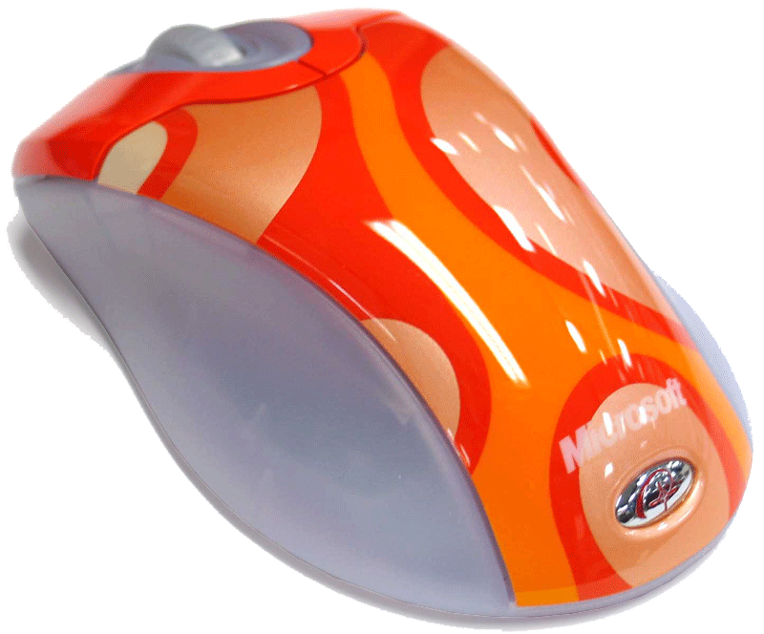
you are making a new input device. You know that it cannot be better than a mouse, but you want to show that it is as good as the mouse.
how do you proceed?
<30sec brainstorming>

Slide 44
how about you run a test and if stats come out non-significant you write “our tests showed that there was no difference”?
nope!
significant difference → mechanisms different
no significant difference →
nothing

Slide 45
so how do you prove that two mechanisms are the same?

Slide 46
in both cases, there are two explanations
same shoes
different shoes
your shoes
questionable shoes
this does seem not unlikely…
no thus
…thus…
you cannot

Slide 47
how to report non-significant results:
“our test did not find a significant difference”

Slide 48
practically

Slide 49
you want to test the effect of two soporific drugs (independent variable) on amount of sleep(dependent variable). You take 10 participants and make then sleep to get their basic (control) sleep time. Then you give them drug 1 and note the difference of sleep time. You do the same for drug 2.
sleep extra drug 1
1 0.7
2 -1.6
3 -0.2
4 -1.2
5 -0.1
6 3.4
7 3.7
8 0.8
9 0.0
10 2.0
sleep extra drug 2
1 1.9
2 0.8
3 1.1
4 0.1
5 -0.1
6 4.4
7 5.5
8 1.6
9 4.6
10 3.4

Slide 50
R
in your terminal
head(sleep) # sleep is the table that already comes with R and contain 20 observations on 10 patients to show the effect of two soporific drugs on the increase in hours of sleep
plot(extra ~ group, data = sleep)
with(sleep, t.test(extra[group == 1], extra[group == 2]))# unpaired
with(sleep, t.test(extra[group == 1], extra[group == 2], paired = TRUE))# paired
you then have two options for t-test: paired or unpaired
Notes:
head(cars) # cars is a table that already comes with R and contain 50 observations of speed and distance in two rows
scatter.smooth(x=cars$speed, y=cars$dist, main="Dist ~ Speed") # scatterplot
linearMod <- lm(dist ~ speed, data=cars) # build linear regression model on full data
summary(linearMod) # summary(linearMod)$r.squared
abline(linearMod, col="blue")

Slide 51
R
you want to test the effect of two soporific drugs (independent variable) on amount of sleep(dependent variable). You take 10 participants and make then sleep to get their basic (control) sleep time. Then you give them drug 1 and note the difference of sleep time. You do the same for drug 2.
all participants did both conditions, i.e. had both drugs
= within subject experiment so the data is paired
otherwise (e.g. take 10 new participants for drug 2)
= between subject experiment so the data is unpaired

Slide 52
R
between subject experiment
with(sleep, t.test(extra[group == 1], extra[group == 2]))# unpaired
data: extra[group == 1] and extra[group == 2]
t = -1.8608, df = 17.776, p-value = 0.07939
alternative hypothesis: true difference in means is not equal to 0
95 percent confidence interval: -3.3654832 0.2054832
sample estimates: mean of x mean of y 0.75 2.33
what you would write
“An unpaired student t-test showed no significant difference between the two drugs.”
Notes:
head(cars) # cars is a table that already comes with R and contain 50 observations of speed and distance in two rows
scatter.smooth(x=cars$speed, y=cars$dist, main="Dist ~ Speed") # scatterplot
linearMod <- lm(dist ~ speed, data=cars) # build linear regression model on full data
summary(linearMod) # summary(linearMod)$r.squared
abline(linearMod, col="blue")

Slide 53
R
within subject experiment
with(sleep, t.test(extra[group == 1], extra[group == 2], paired = TRUE))# paired
data: extra[group == 1] and extra[group == 2]
t = -4.0621, df = 9, p-value = 0.002833
alternative hypothesis: true difference in means is not equal to 0
95 percent confidence interval: -2.4598858 -0.7001142
sample estimates: mean of the differences -1.58
what you would write
“A paired student t-test showed significant difference between the two drugs (two-tailed t(9)=-4.0621, p < 0.05)”
Notes:
head(cars) # cars is a table that already comes with R and contain 50 observations of speed and distance in two rows
scatter.smooth(x=cars$speed, y=cars$dist, main="Dist ~ Speed") # scatterplot
linearMod <- lm(dist ~ speed, data=cars) # build linear regression model on full data
summary(linearMod) # summary(linearMod)$r.squared
abline(linearMod, col="blue")

Slide 54
(note: try to design your studies within-subject as it will increase the chance to reach a smaller p-value
… otherwise need twice more participants!)

Slide 55
R
one vs. two tail?
with(sleep, t.test(extra[group == 1], extra[group == 2], paired = TRUE, alternative=”less")) # or “greater”
Paired t-test
data: extra[group == 1] and extra[group == 2]
t = -4.0621, df = 9, p-value = 0.001416
alternative hypothesis: true difference in means is less than 0
95 percent confidence interval: -Inf -0.8669947
sample estimates: mean of the differences -1.58
what you would write
“A paired student t-test showed significant difference between the two drugs (one-tailed t(9)=-4.0621, p < 0.001).”
Notes:
head(cars) # cars is a table that already comes with R and contain 50 observations of speed and distance in two rows
scatter.smooth(x=cars$speed, y=cars$dist, main="Dist ~ Speed") # scatterplot
linearMod <- lm(dist ~ speed, data=cars) # build linear regression model on full data
summary(linearMod) # summary(linearMod)$r.squared
abline(linearMod, col="blue")

Slide 56
two-tails: effect of drug 1 is > and/or < Drug 2
one-tail: only one side of the effect, i.e.
effect of Drug 1 > Drug 2 (less)
or
effect of Drug 1 < Drug 2 (greater)
e.g. created a shampoo for hair loss and
want to know if better than concurrent one

Slide 57
(note: you will mostly use two-tails but if you can use a one-tail do it, it will increase the chance to reach a smaller p-value!)

Slide 58
multiple
variables

Slide 59
what if we have more than two variables?

Slide 60

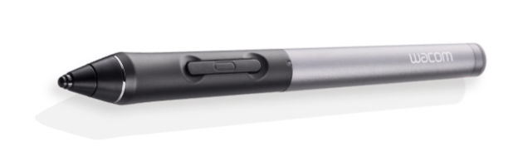
you are making two new input devices, a track pad and a stylus. You want to know which one is better and if they are also better than a mouse.
how do we proceed?
<30sec brainstorming>

Slide 61
a simple solution would be to do this …
ttest1
ttest2
ttest3

Slide 62
a simple solution would be to do this …
problem: any given test has a 5% chance of lying to you so when you use them multiple time you increase your risk of having errors (statisticians call this a “type I error”)
5%
5%
ttest1
ttest2
5%
ttest3

Slide 63
so there are two solutions to that:

Slide 64
bonferroni correction ::
when testing n hypotheses, test each one against 0.05/n

Slide 65
bonferroni correction ::
when testing n hypotheses, test each one against 0.05/n
in our example we would need to use 0.05/3 as a significant threshold instead of 0.05

Slide 66
anova::
analyze of variance to compare multiple variables
one-way anova = one variable with multiple levels
two-way anova = two variables with multiple levels
or you could also use an

Slide 67
… we will look at ANOVA in the next few weeks

Slide 68
continuous independent variable
What type of data?
discrete independent variable
continuous dependent variable
discrete dependent variable
Continuous dependent variable
Discrete/categorical dependent variable
regressions
logistic
regressions
normally distributed
skewed
2 grp
>2 grp
2 grp
>2 grp
2 grp
>2 grp
Non paired
paired
Non paired
paired
Non paired
paired
Non paired
paired
Counts >= 5 in >= 75% cells
Counts >= 5 in < 75% cells
T-test
ANOVA
Mann-Whitney Utest
Wilcoxon signed rank test
Kruskall-Wallis test
Chi-square test
Fisher’s exact test
Chi-square test
Paired-t-test
Friiedman test
McNemar’s test

Slide 69
take away
Explain what is hypothesis testing
Identify the limit of hypothesis testing (we cannot prove that things are similar)
Explain what is a p value and a significance value
Explain what is a t-test and when to use it
Explain the difference between within and between subject studies
Explain what is a Bonferroni correction and find the new significance level given an experimental design

Slide 70
end

